Slide 1
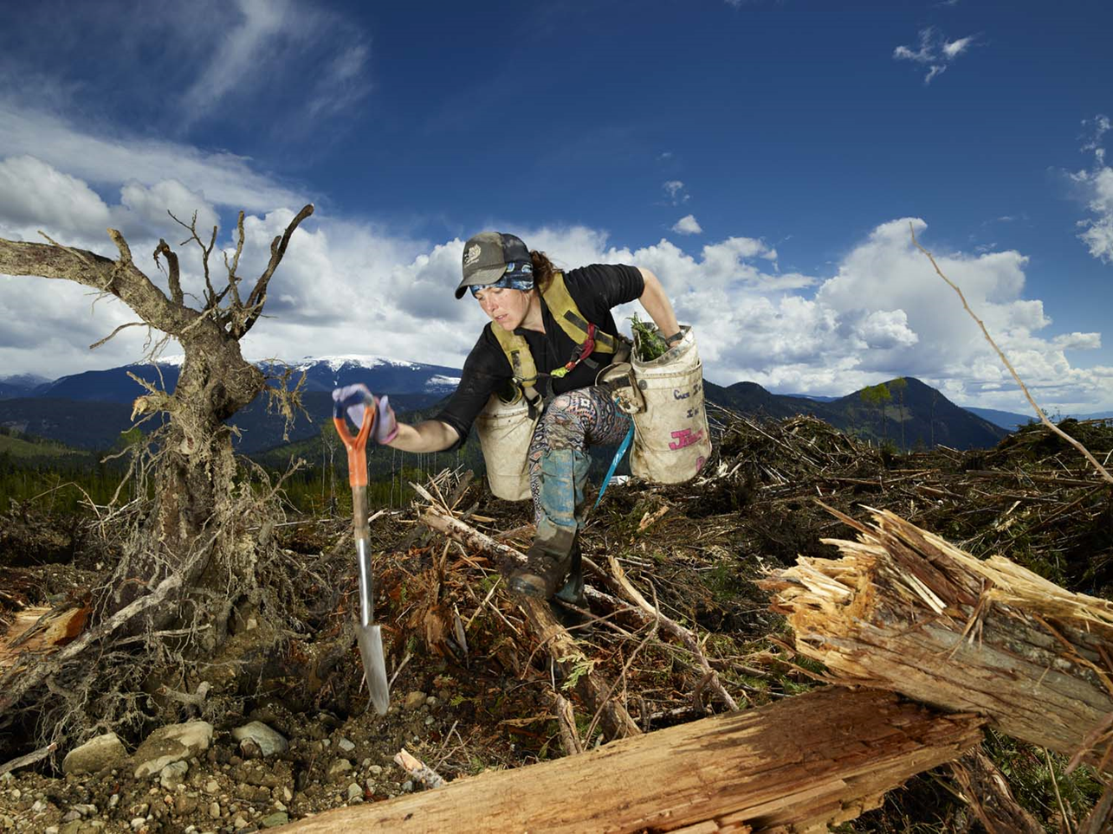

Pining for home:
reforestation in a changing climate
Greg O’Neill
British Columbia Ministry of Forests
for Bureau National des Forêts
August 31 2023
Photo: Rita Leistner
Notes:
Switching gears to applied
policy, BC 300MM

Slide 2
Outline
Climate change impacts
Migration Distance and Safe Seed Transfer Distance.
Climate Based Seed Transfer
Assisted migration risks
Photo: Rita Leistner
Notes:
Switching gears to applied
policy, BC 300MM

Slide 3
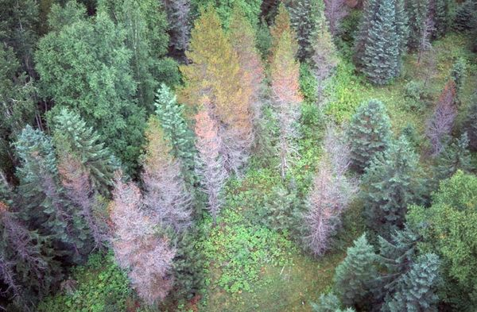
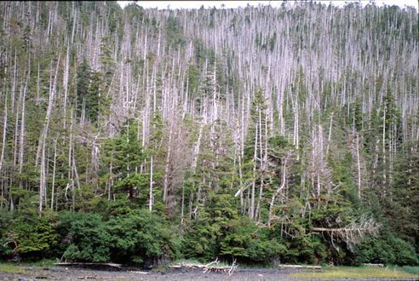
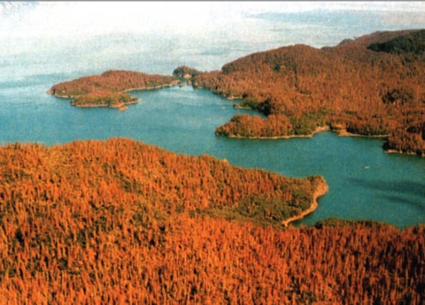
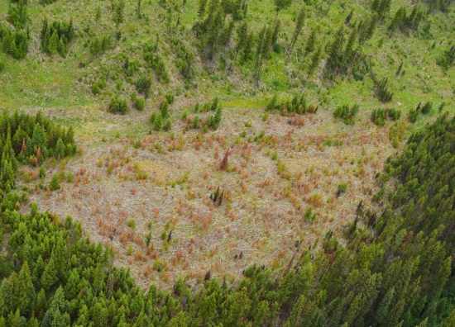
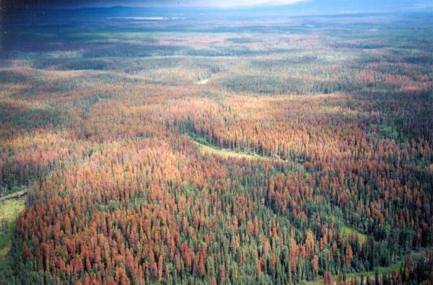
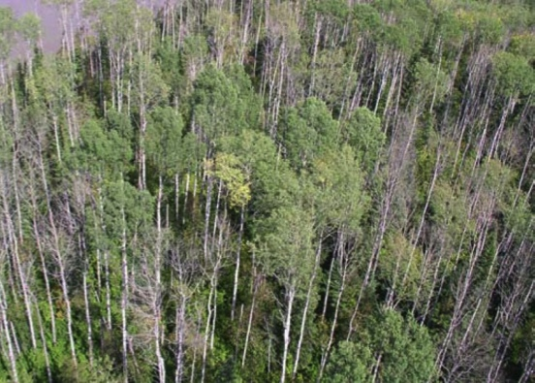
Pining for home
CBST AMAT Other CC Strategies Health
Photo: Alex Woods
Dothistroma needle cast
Photo: P. Hennon
Yellow-cedar decline - Alaska
Photo: Ed Halsten
Spruce beetle - Alaska
Photo: Kevin Buxton
Drought mortality- Okanagan
Photo: L. McLachlan
Mountain pine beetle
Photo: T. Hogg
Spruce and aspen dieback
Notes:
All partially related to CC
To the extent that pops differ in their tolerance of these traits, and differences are patterned on seed source climate, may be able to address these problems through strategic population selection during reforestation.

Slide 4
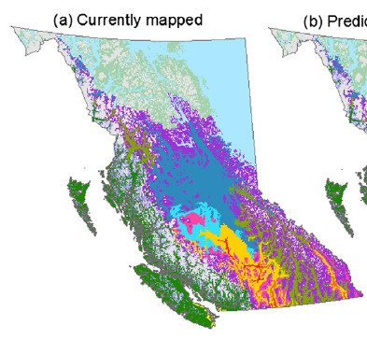
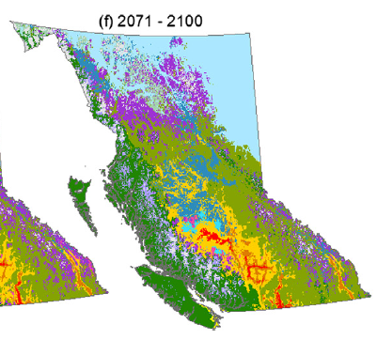
Pining for home
CBST AMAT Other CC Strategies Health
Climate niche of BC’s biogeoclimatic zones
Wang et al. Forest Ecology and Management 2012

Slide 5
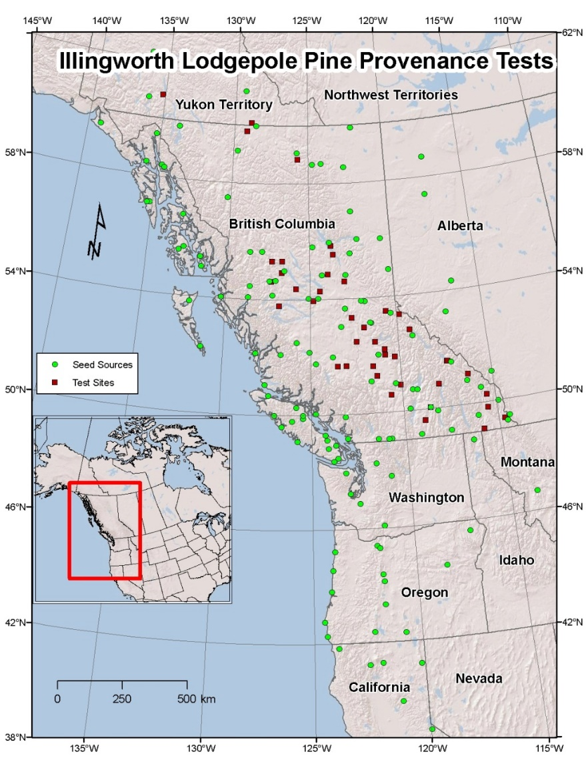
Pining for home
CBST AMAT Other CC Strategies Health
Lodgepole pine provenance trial – established 1974
Image: Susan Zedel
Notes:
Experimental evidence that CC not good for trees.
65 000 trees; 62 locations; 140 pops
Age 35

Slide 6
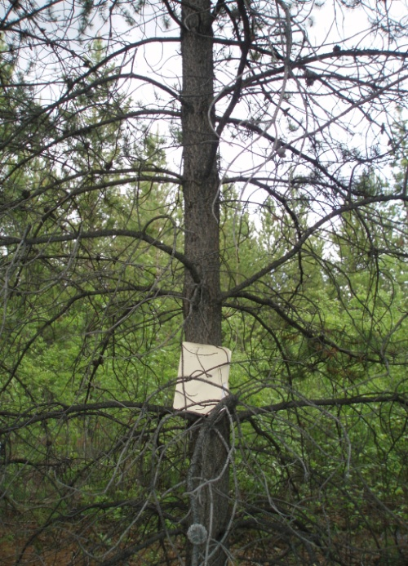
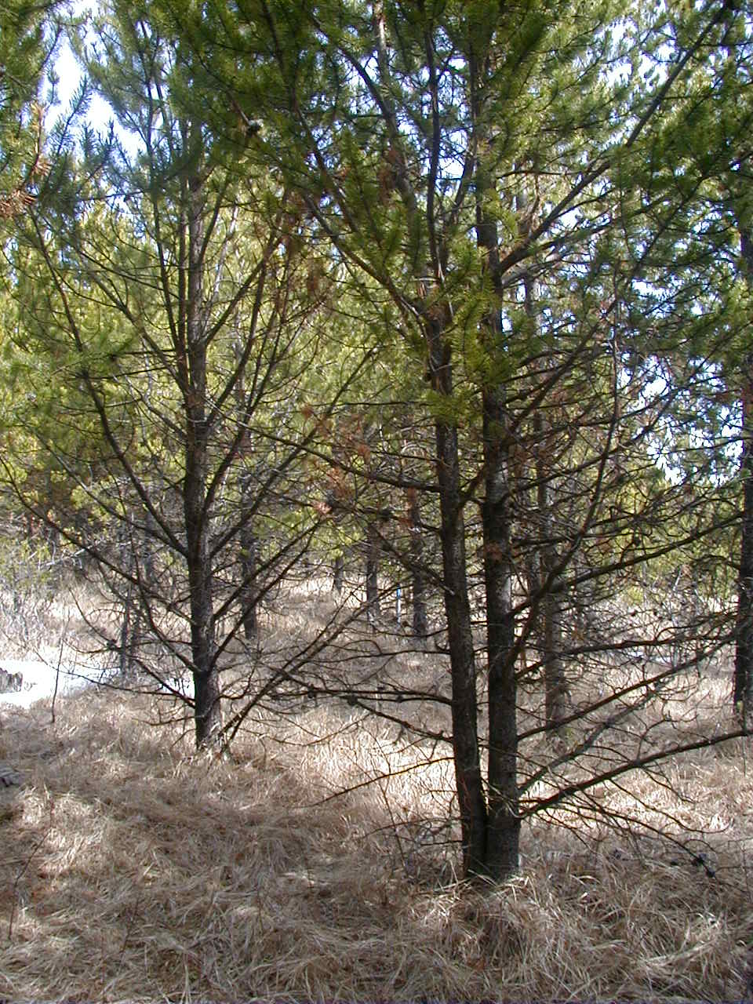
Pining for home
CBST AMAT Other CC Strategies Health
Climate change is not good for trees!
Seed source -1.3 °C MAT
Plantation -1.3 °C MAT
Seed source -1.3 °C MAT
Plantation 2.9 °C MAT

Slide 7
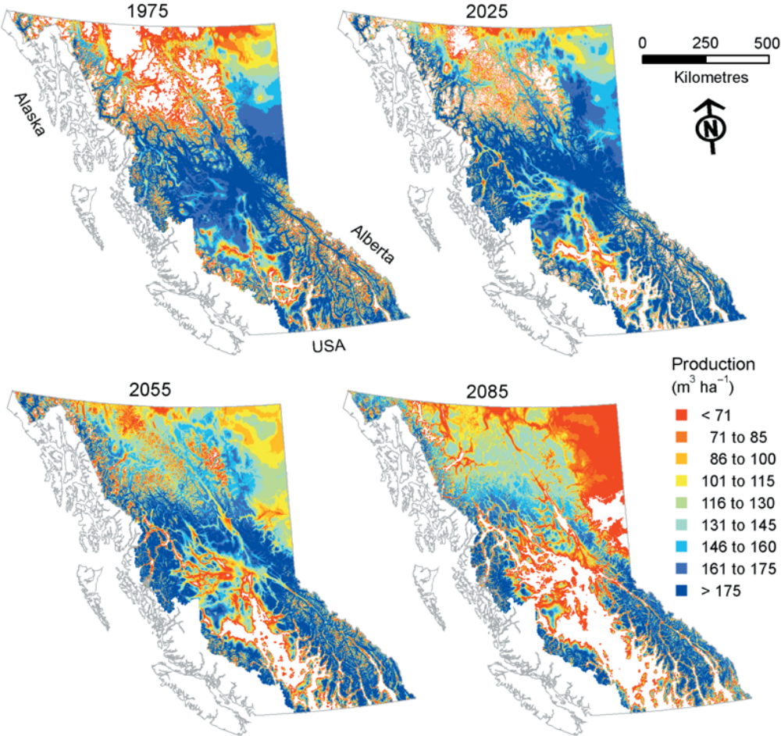
Lodgepole pine productivity
Productivity decline: 10-30% by 2080
O’Neill, Wang, Hamann 2008
Notes:
When population differentiation is considered, rarely are predictions of long term growth impacts of CC positive.

Slide 8
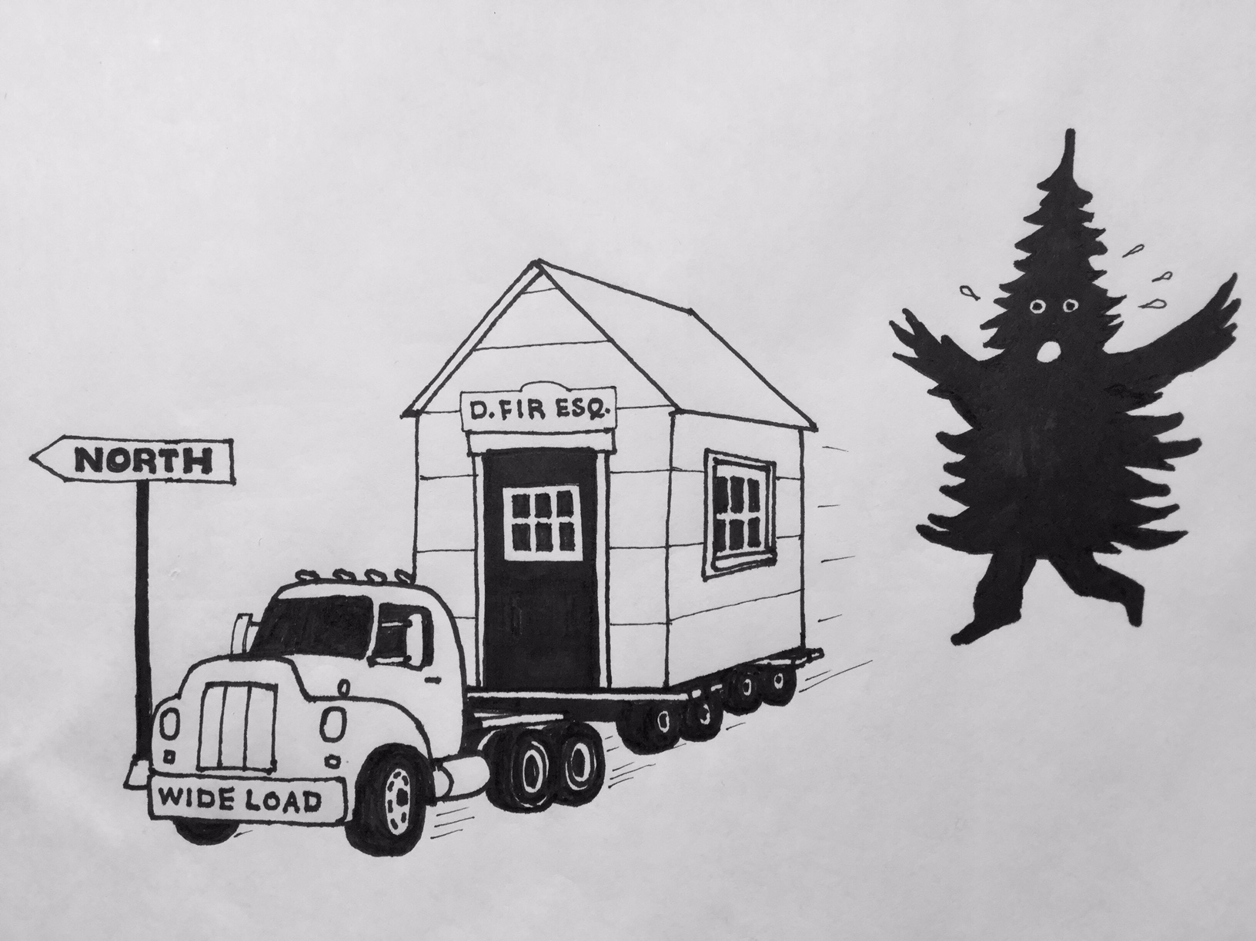
Image: Peter Strother

Slide 9
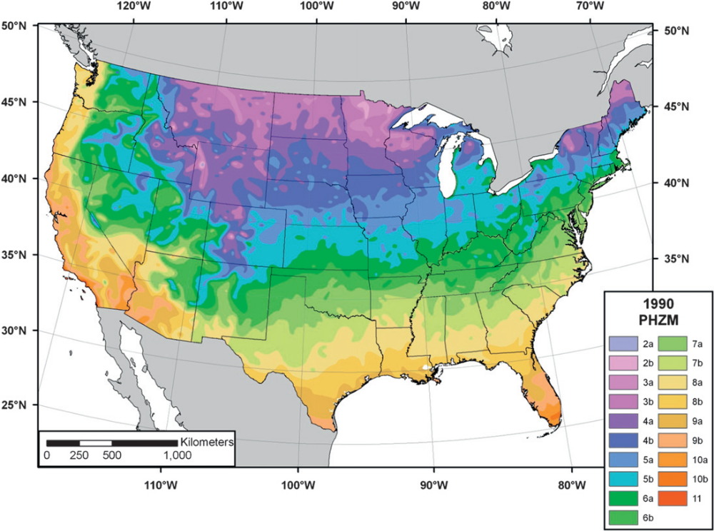
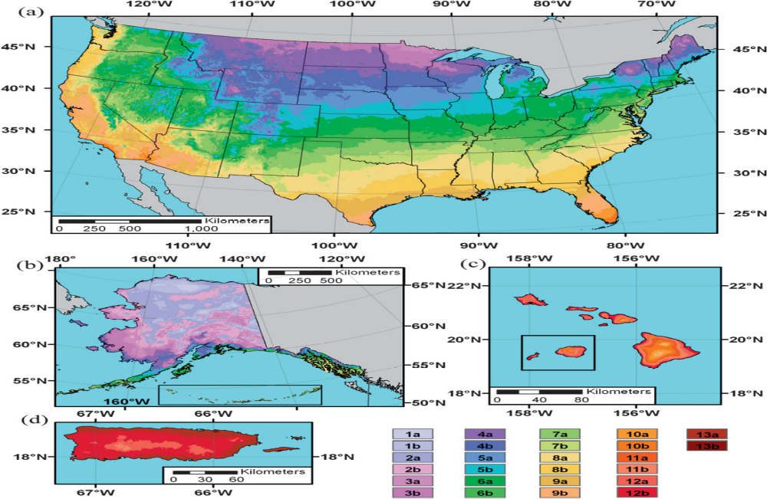
Assisted migration is being used in horticulture
1990 Plant Hardiness Zone Map
2012 Plant Hardiness Zone Map
C. Daly. 2010. J. Appl. Met. Clim.
Notes:
The good news: AM can mitigate CC impacts
AM is the movement of trees to track CC
Achieved by planting trees from a climate slightly warmer than the planting site
Most widely studied and supported CC adaptation strategy

Slide 10

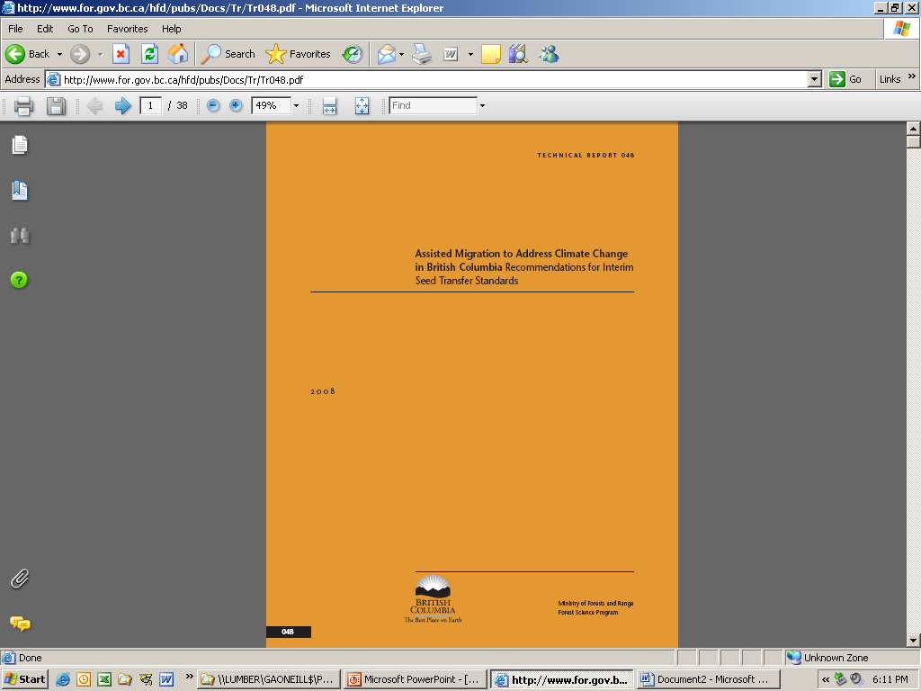

Pining for home
CBST AMAT Other CC Strategies Health
Up good. Down bad.
Notes:
AM within species can be achieved by moving populations uphill. But this strategy does not resolve the need to move populations poleward.

Slide 11
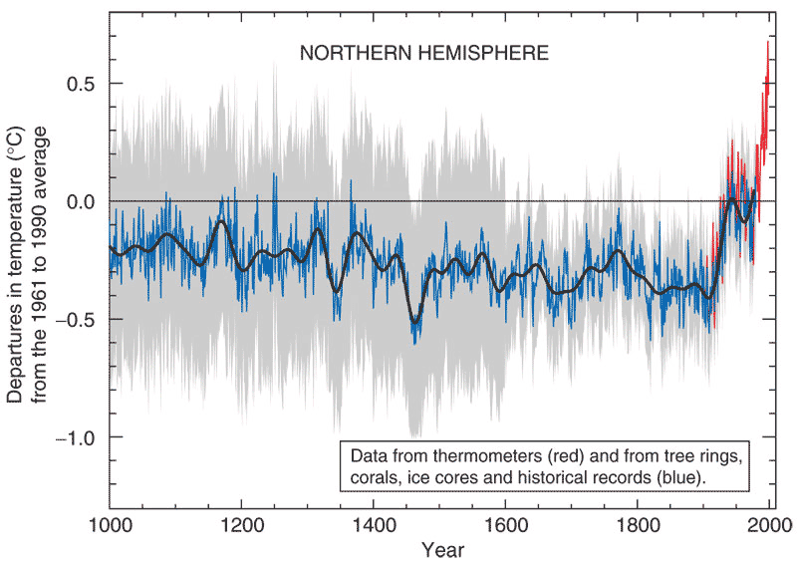
Proxy temperatures
Future
lag
Observed temperatures
Migration distance
Evolutionary lag
IPCC 2001
Notes:
Fitness peak
Temp deviation graph > insight to tree happy place
CC faster Migration > lag (correct for the sins of the past)
Beginning and end can be ascertained very accurately
If you plant a tree perfectly adapted to today’s climate….
Genetic restoration

Slide 12
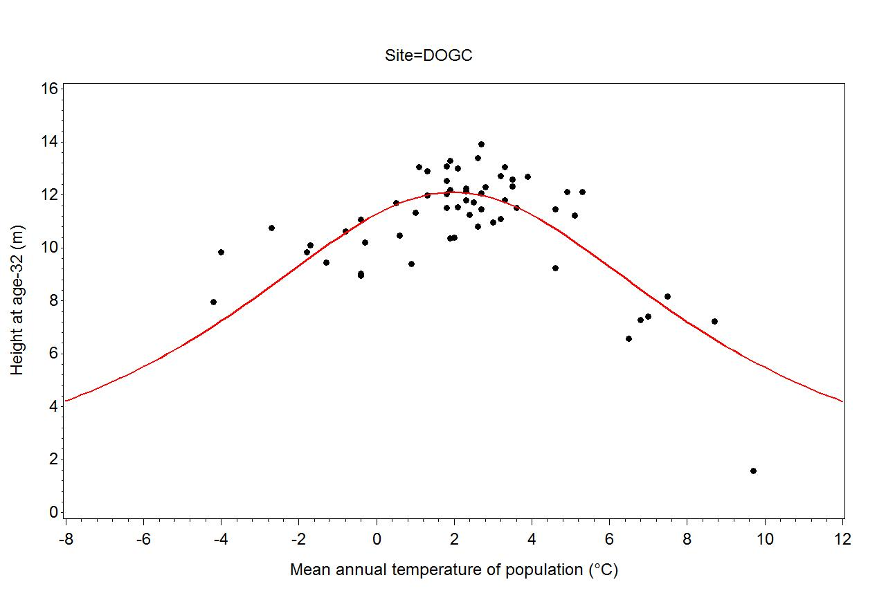
Safe Seed Transfer Distance
DOGC
HT_{opt}
HT₉₀
SSTD
SSTD

Slide 13
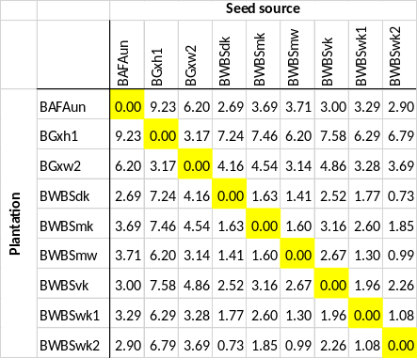
Climate Change Adaptation Research
CBST AMAT Other CC Strategies Multispectral Health
Building CBST
Climate means of plantation BECvars
Climate means of seed BECvars
A) Calculate Euclidean climate distance between each pair of ecosystems. (If prov data lacking, could stop here and permit transfers only between pairs that are climatically close.)
Climate distance matrix

Slide 14
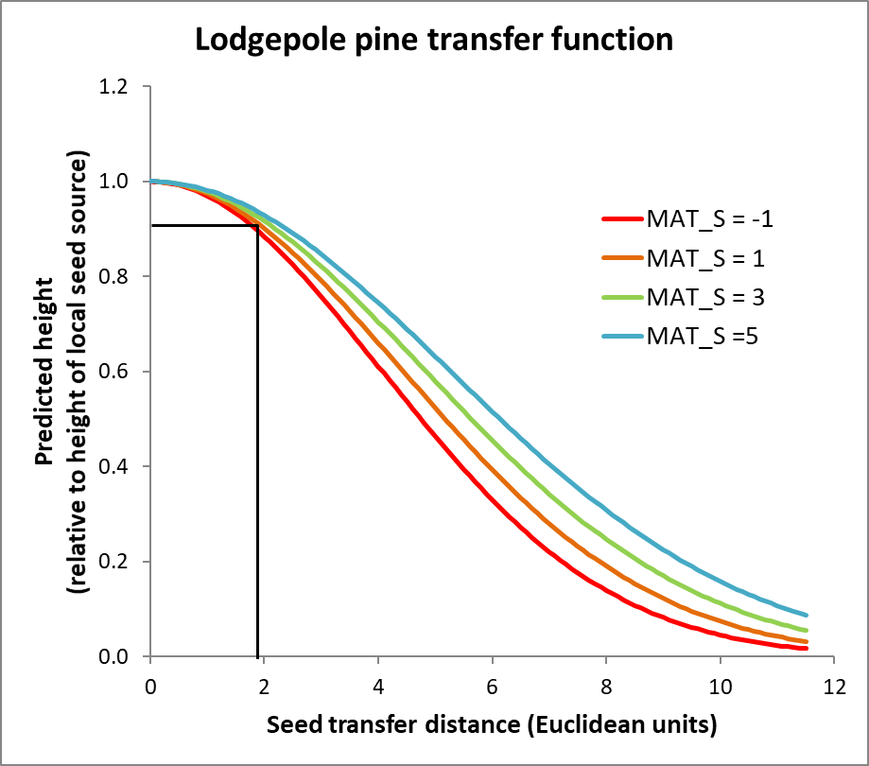
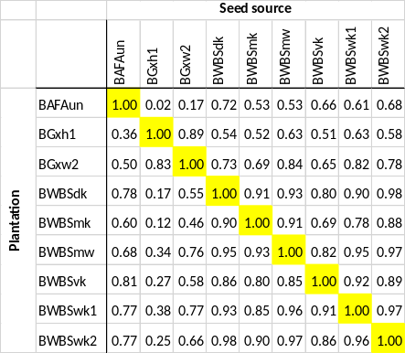
Climate Change Adaptation Research
CBST AMAT Other CC Strategies Multispectral Health
Building CBST
Provenance data
B) A given climate transfer distance does not have the same impact on different species. Therefore, If prov data available, develop a transfer function and use it to predict inter-ecosystem transfer impacts.
Climate means of plantation BECvars
Climate means of seed BECvars
A) Calculate Euclidean climate distance between each pair of ecosystems. (If prov data lacking, could stop here and permit transfers only between pairs that are climatically close.)
Climate distance matrix
Relative height matrix

Slide 15
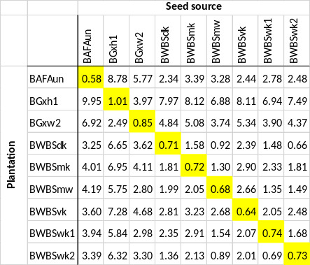
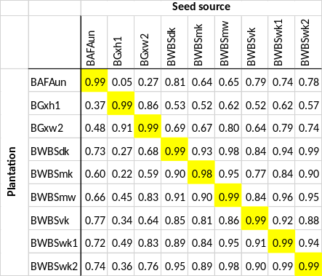
Climate Change Adaptation Research
CBST AMAT Other CC Strategies Multispectral Health
Building CBST
Provenance data
B) A given climate transfer distance does not have the same impact on different species. Therefore, If prov data available, develop a transfer function and use it to predict inter-ecosystem transfer impacts.
C) To include assisted migration, add climate migration distance to plantation climates and repeat A and B.
Climate means of plantation BECvars
+
Climate migration distance
Climate means of seed BECvars
A) Calculate Euclidean climate distance between each pair of ecosystems. (If prov data lacking, could stop here and permit transfers only between pairs that are climatically close.)
Climate distance matrix
Relative height matrix
Genetic suitability

Slide 16
Climate Change Adaptation Research
CBST AMAT Other CC Strategies Multispectral Health
Building CBST
Provenance data
B) A given climate transfer distance does not have the same impact on different species. Therefore, If prov data available, develop a transfer function and use it to predict inter-ecosystem transfer impacts.
C) To include assisted migration, add climate migration distance to plantation climates and repeat A and B.
Climate means of plantation BECvars
+
Climate migration distance
Climate means of seed BECvars
A) Calculate Euclidean climate distance between each pair of ecosystems. (If prov data lacking, could stop here and permit transfers only between pairs that are climatically close.)
Climate distance matrix
Relative height matrix
Genetic suitability
D) Identify those inter-ecosystem transfers having low transfer impacts (high genetic suitability).

Slide 17
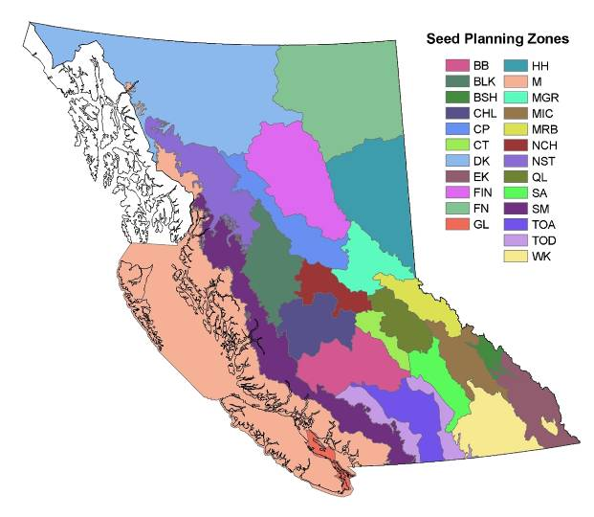
Pining for home
CBST AMAT Other CC Strategies Health
Geographic Based Seed Transfer

Slide 18
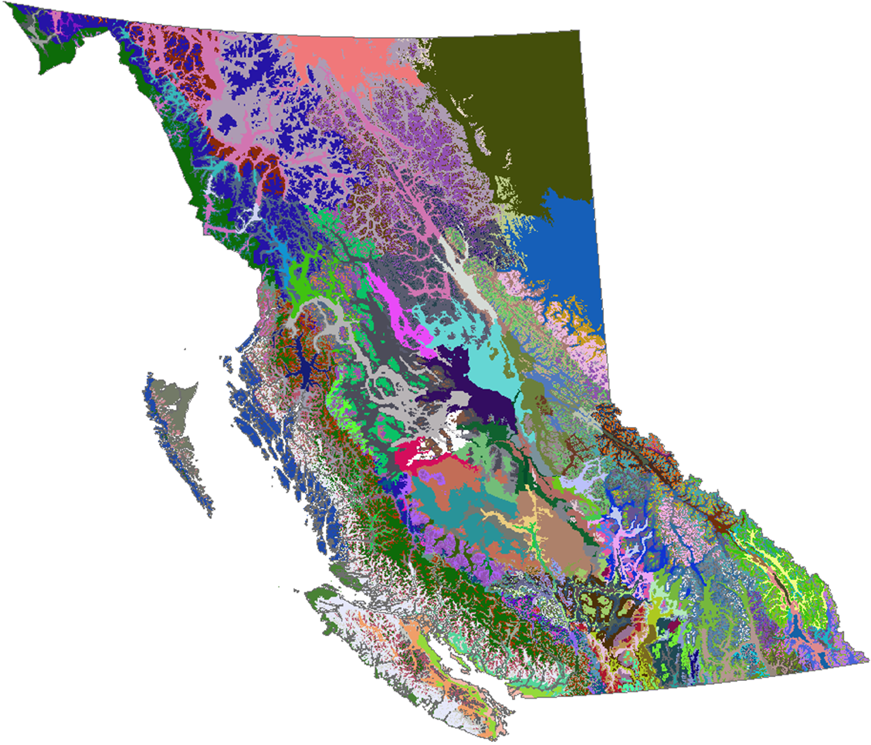
Pining for home
CBST AMAT Other CC Strategies Health
Climate Based Seed Transfer
Biogeoclimatic Ecosystem Classification (BEC) Variants
Image: Tongli Wang

Slide 19
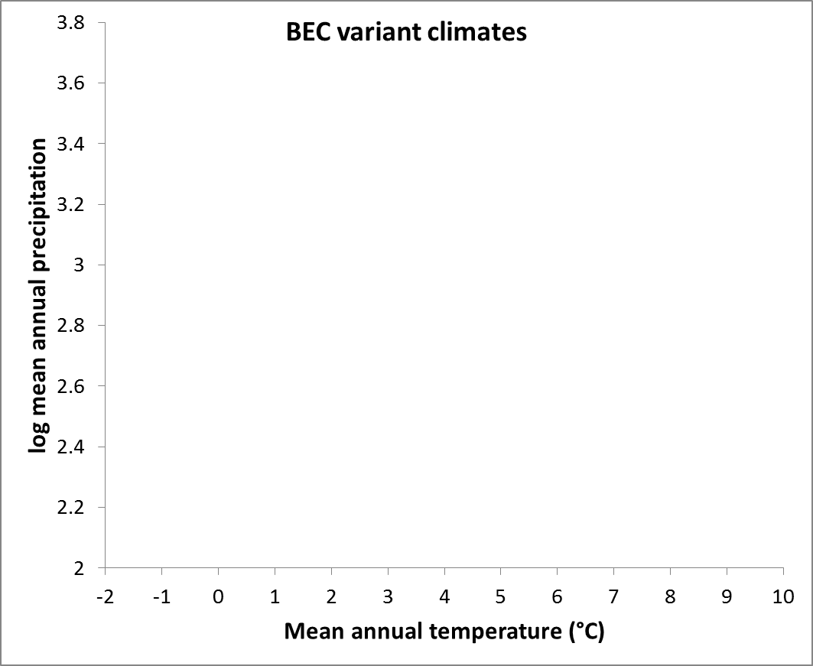

Pining for home
CBST AMAT Other CC Strategies Health
BEC units

Slide 20
Pining for home
CBST AMAT Other CC Strategies Health
BEC units
Seedlot

Slide 21
Pining for home
CBST AMAT Other CC Strategies Health
BEC units
Seed deployment space
Seedlot
Notes:
Risk
plant local seed is from a location 1.5 °C colder than plantation
AM seed is from a location 0.5 °C warmer than plantation

Slide 22
Pining for home
CBST AMAT Other CC Strategies Health
BEC units
Seed deployment space
Seedlot

Slide 23
Pining for home
CBST AMAT Other CC Strategies Health
BEC units
Seed deployment space
Seedlot

Slide 24
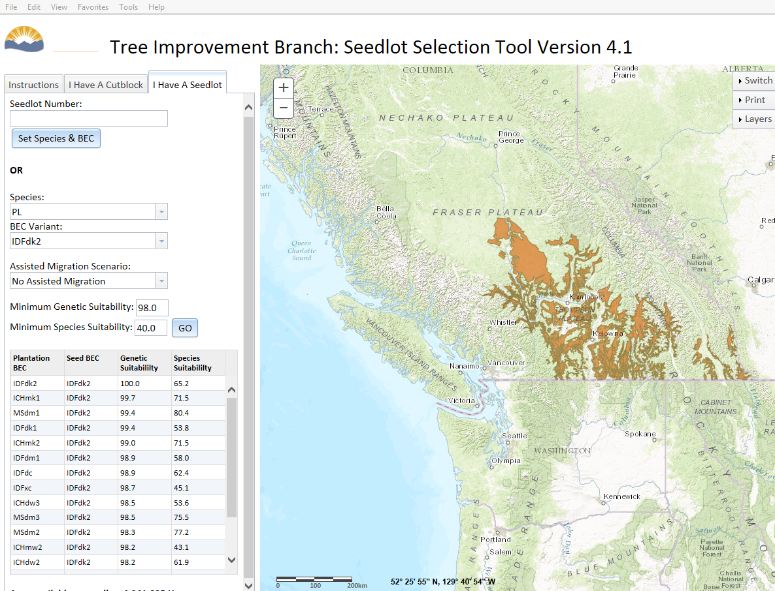

Slide 25
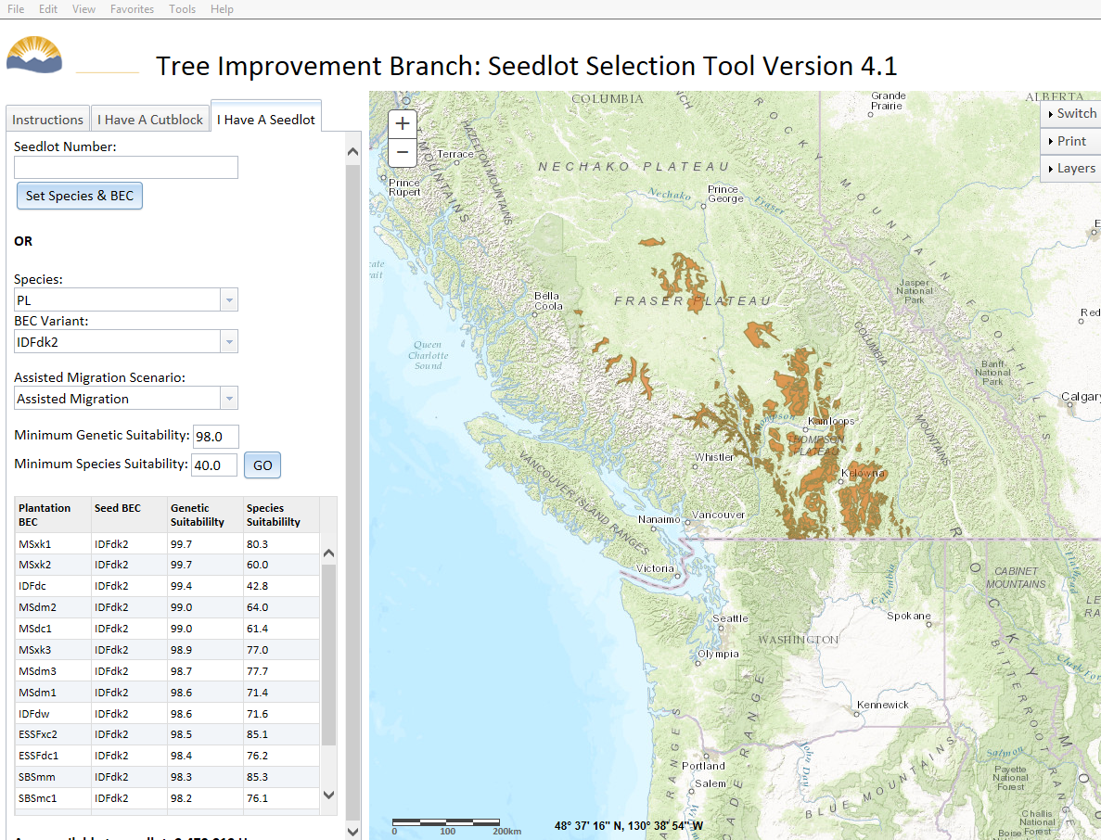
Notes:
Implemented this month

Slide 26
Pining for home
CBST AMAT Other CC Strategies Health
BEC units
Cutblock
Notes:
Risk
plant local seed is adapted to a climate 1.5 °C colder than plantation
AM seed is adapted to a climate 0.5 °C warmer than plantation

Slide 27
Pining for home
CBST AMAT Other CC Strategies Health
BEC units
Cutblock
Notes:
Risk
plant local seed is adapted to a climate 1.5 °C colder than plantation
AM seed is adapted to a climate 0.5 °C warmer than plantation

Slide 28
Pining for home
CBST AMAT Other CC Strategies Health
BEC units
Cutblock
Notes:
Risk
plant local seed is adapted to a climate 1.5 °C colder than plantation
AM seed is adapted to a climate 0.5 °C warmer than plantation

Slide 30
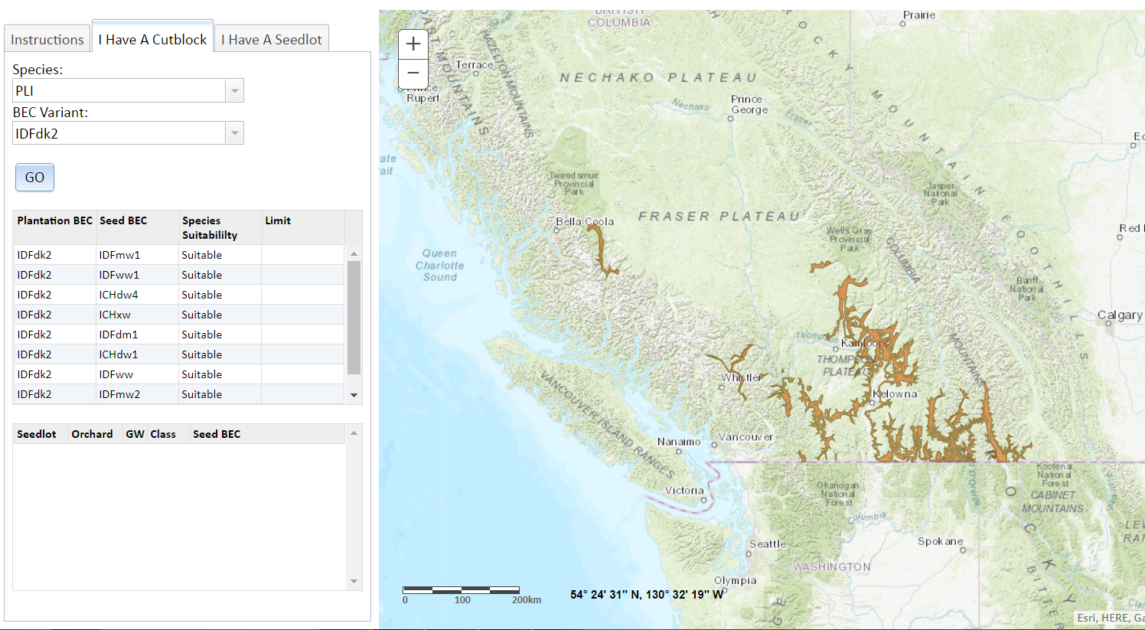

Slide 31
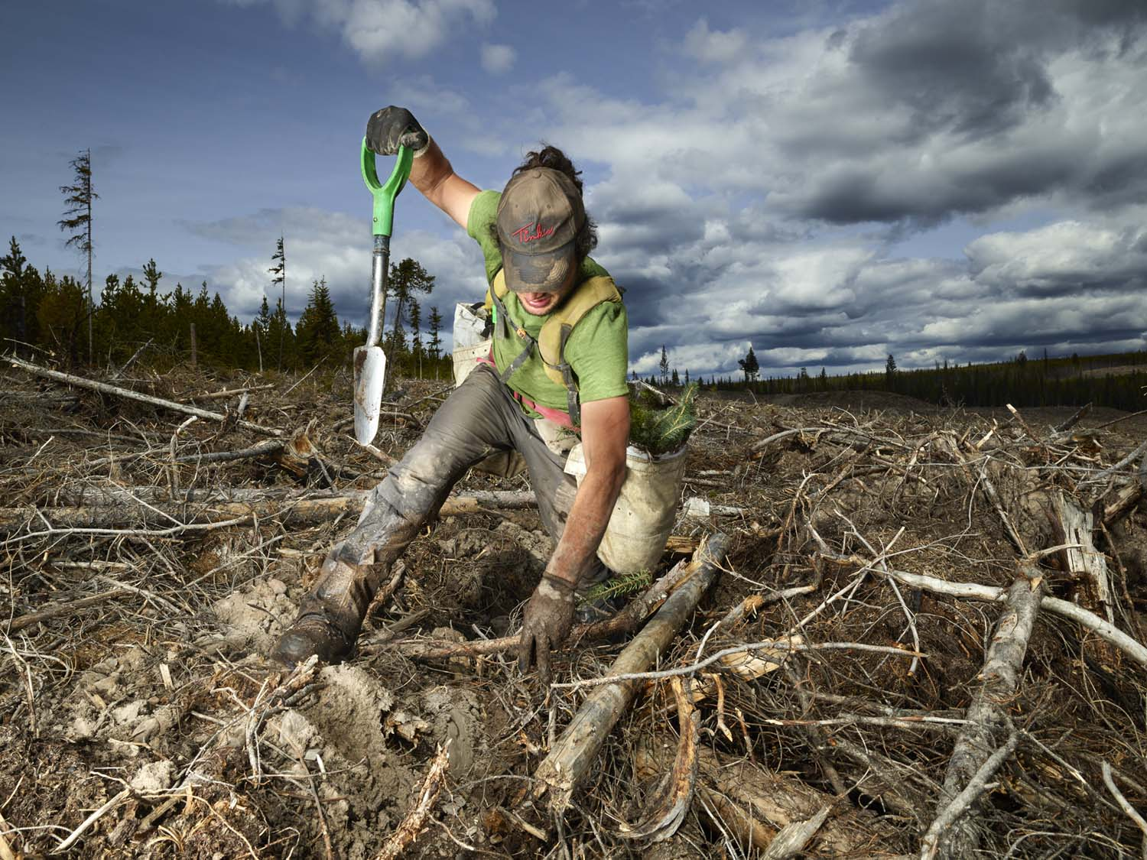
Pining for home
CBST AMAT Other CC Strategies Health
Summary
Climate change is impacting trees now
AM is straightforward, low cost, low risk
Focal zone system provides flexibility, is transparent and maximizes deployabililty
CBST requires safe seed transfer distance and migration distance to be calculated.
Photo: Rita Leistner
Notes:
Switching gears to applied
policy, BC 300MM

Slide 32
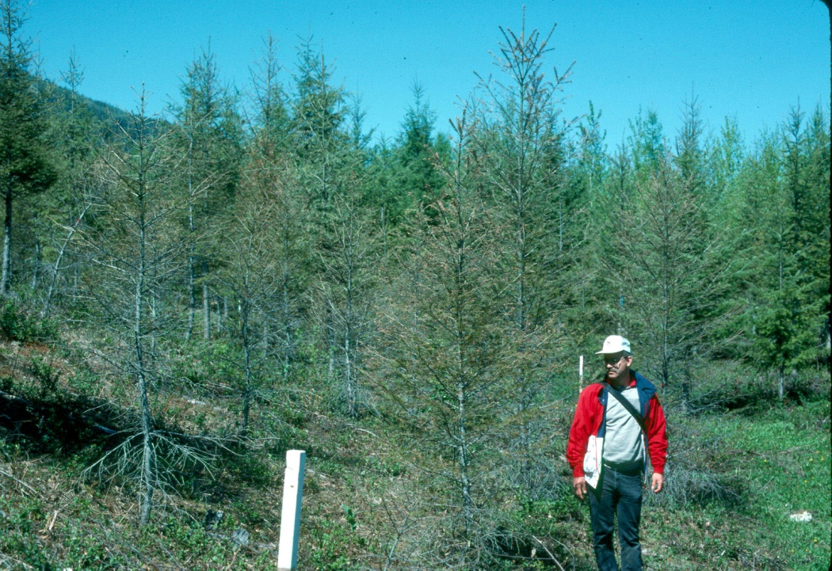
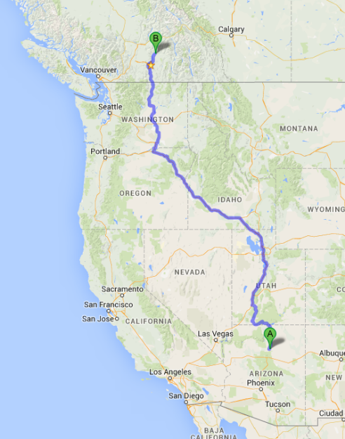
Pining for home
CBST AMAT Other CC Strategies Health
AM risks – over-transfer
Image: B. Jaquish
Douglas-fir
20 years old
Notes:
Fd prov trial near Vernon – age-20
Winter dessication/rhabdocline needle cast
AM being considered – substantially shorter climate, geog and ecol dist
Should not be haphazard

Slide 33
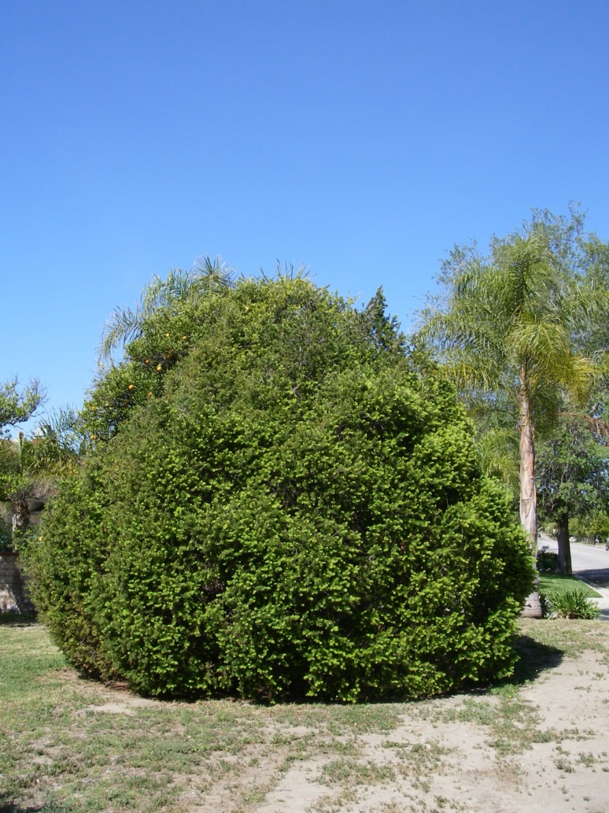
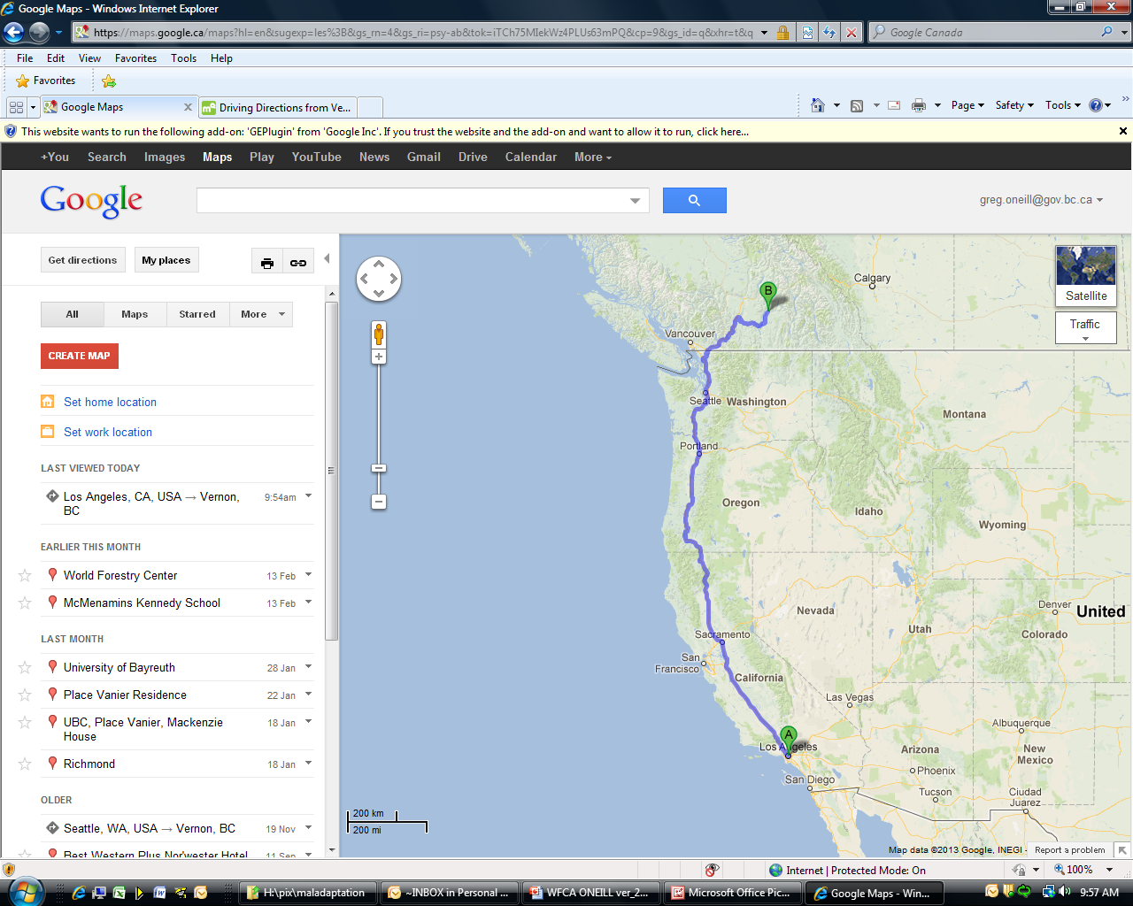
Pining for home
CBST AMAT Other CC Strategies Health
AM risks – over-transfer
Image: B. Jaquish
Image: M. Carlson
Douglas-fir
20 years old
Notes:
Fd prov trial near Vernon – age-20
Winter dessication/rhabdocline needle cast
AM being considered – substantially shorter climate, geog and ecol dist
Should not be haphazard

Slide 34
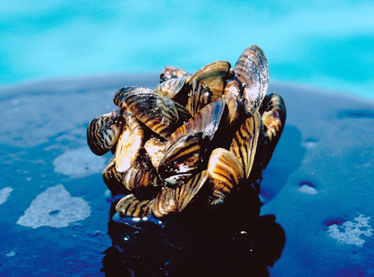
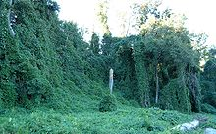
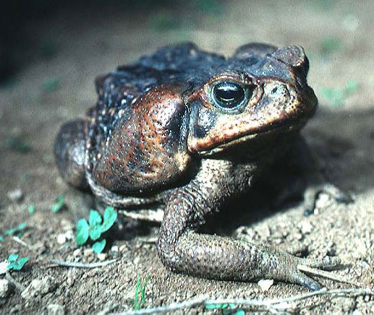
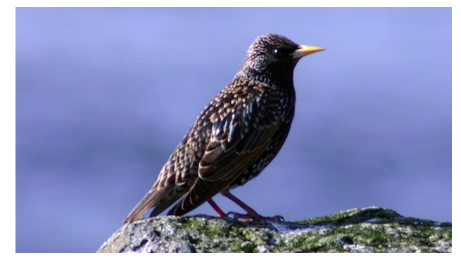
Pining for home
CBST AMAT Other CC Strategies Health
AM risks – species invasion
Well-intentioned/accidental exotic translocations → unanticipated ecological disturbances
Kudzu
photo: S. Erhardt
Zebra mussels
photo: US Fish and Wildlife Service
Cane toad
Photo:E. Greenbaum
Cane toad
Photo:E. Greenbaum
Notes:
Ecological disturbance
Well intentioned or accidental introductions > unanticipated consequences

Slide 35
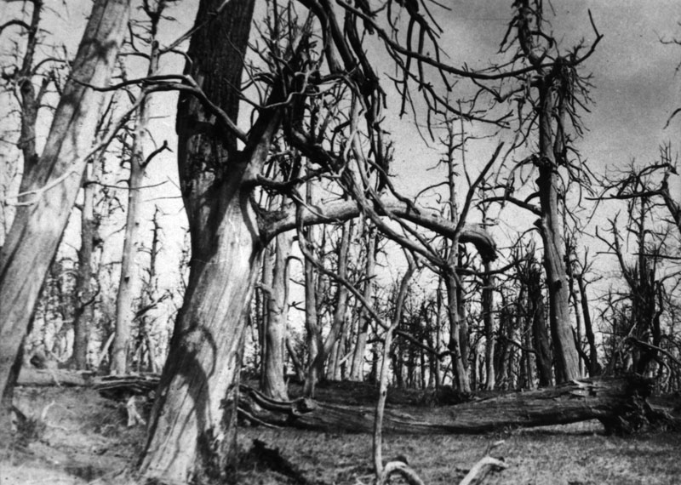
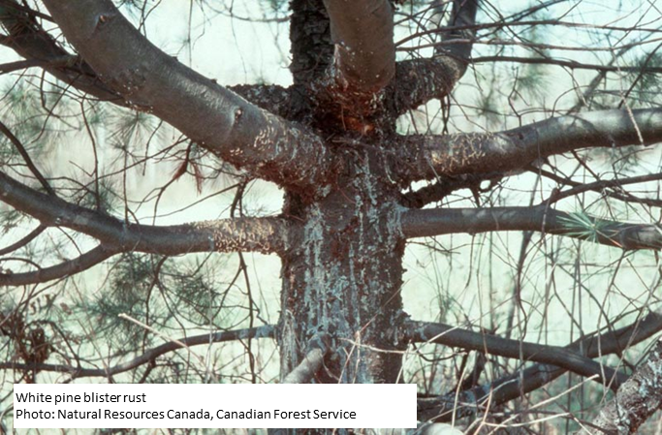
Pining for home
CBST AMAT Other CC Strategies Health
AM risks – hitch-hiking pathogens/insects
American chestnut blight
Photo: American Chestnut Foundation
Use of AM in forestry does not involve procuring seed or seedlings from abroad or even from long distances within North America, so risk of introducing pathogens/pests is negligible.

Slide 36
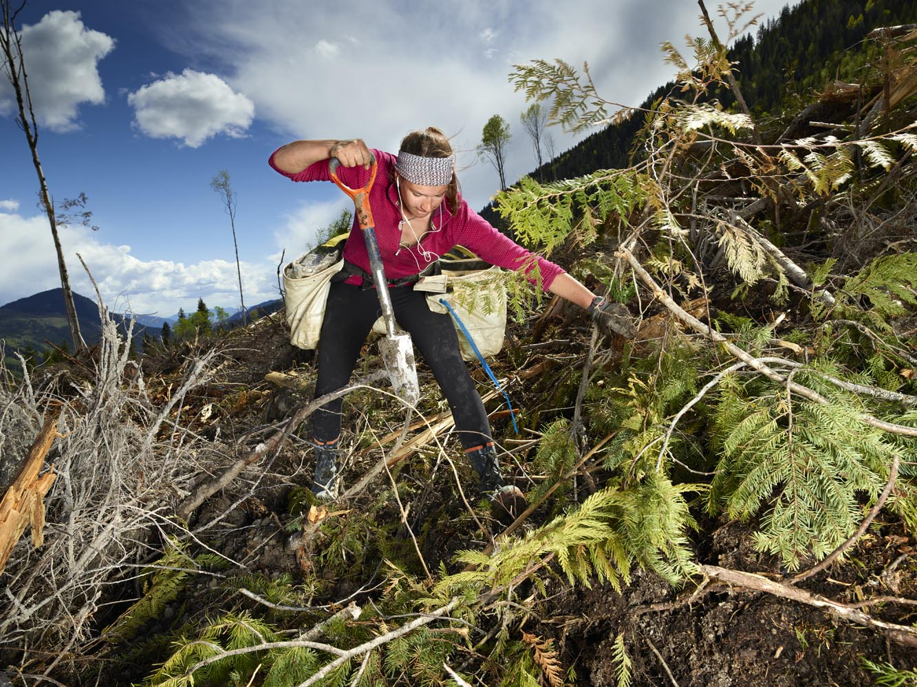
Pining for home
CBST AMAT Other CC Strategies Health
Photo: Rita Leistner
Notes:
Switching gears to applied
policy, BC 300MM

Slide 37
Pining for home
CBST AMAT Other CC Strategies Health
Summary
Climate change is impacting trees now
AM is straightforward, low cost, and low risk
AM is already happening is horticulture and agriculture
Risks of AM due to over-transfer, invasive spread, or hitch-hiking pests are low when as CBST system is used and migration distances are short.
Migration distance accounts for past CC and CC in next 15-20 years.
Safe Seed Transfer Distances (the pink oval) can be calculated from existing seed transfer systems or from prov trials.
CBST restores populations to their historical climate through the use of the migration distance and is therefore transparent and flexible.
Photo: Rita Leistner
Notes:
Switching gears to applied
policy, BC 300MM

Slide 38
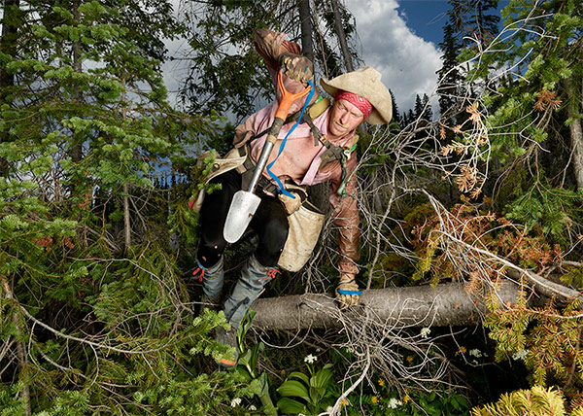
Pining for home
CBST AMAT Other CC Strategies Health
Thank you

